Slide 1
Real-Time Object Tracking and Path Following for Autonomous Vehicles Using Carla Simulator
Authors: Jiarun ZHU, Qijun CAI, Jiayang HE

Slide 2
Outlines
We aimed task is
Carla simulator: CARLA Simulator.

Slide 3
Outlines
1. Background and Significance
2. Analysis of Current Research Status
3. Completed Work
4. Research Plan and Expected Results
5. Potential Challenges and Solutions
6. References

Slide 4
Outlines
1. Background and Significance
2. Analysis of Current Research Status
3. Completed Work
4. Research Plan and Expected Results
5. Potential Challenges and Solutions
6. References

Slide 5
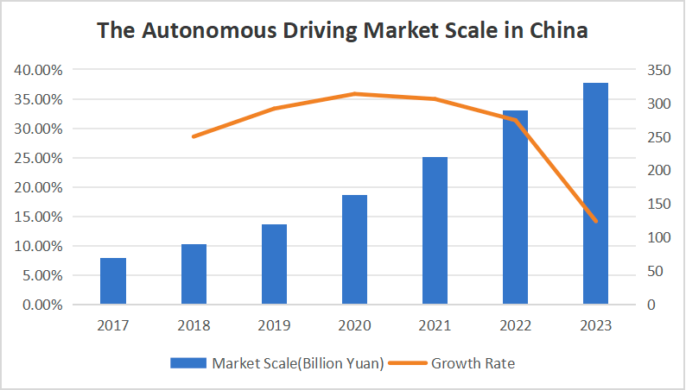
Background and Significance
A. The Rapid Developing Autonomous Driving Technology

Slide 6
Background and Significance
B. Introduction to Object Tracking in Autonomous Driving
1）object tracking is a pivotal task that holds immense importance for
the safe and efffcient operation of autonomous vehicles.
2）In this research project, the image recognition, path planning,
and vehicle control algorithms implemented in our
vehicle tracking system are closely related to the cutting-edge
technologies in autonomous driving.

Slide 7
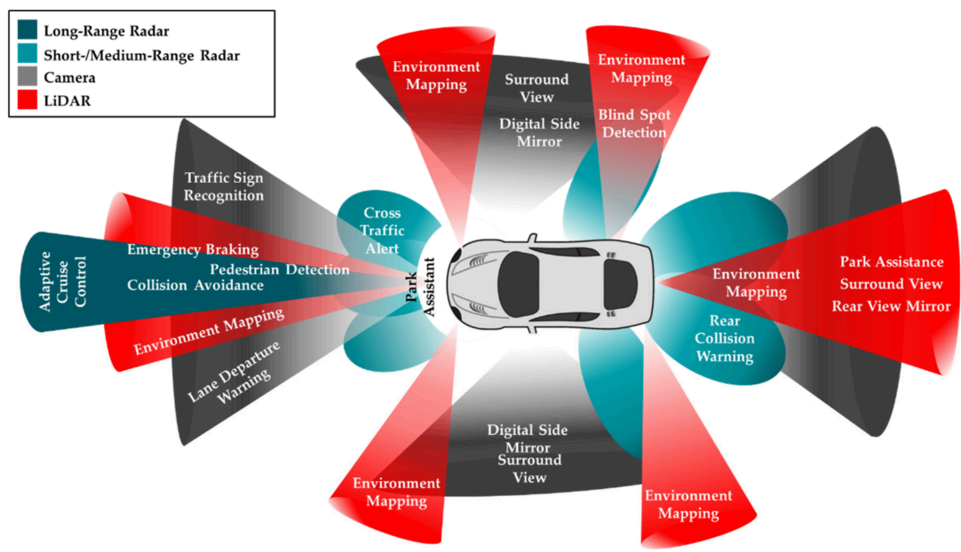
Background and Significance
C. Technologies May Involved in Object Tracking
Sensor Fusion：

Slide 8
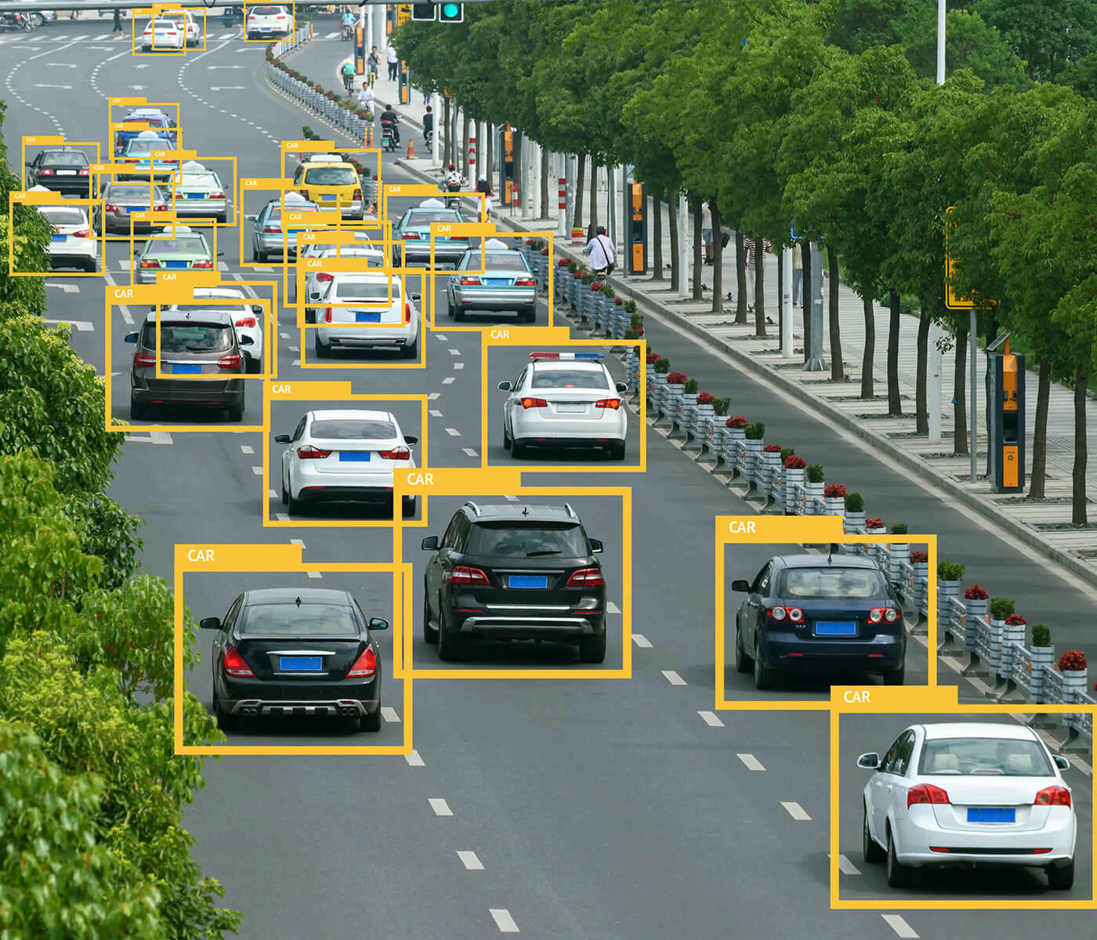
Background and Significance
C. Technologies May Involved in Object Tracking
Object Detection：

Slide 9
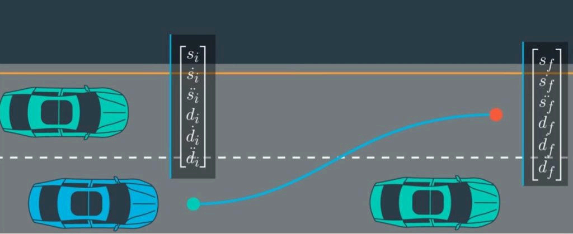
Background and Significance
C. Technologies May Involved in Object Tracking
Path Planning and Control Algorithm:

Slide 10
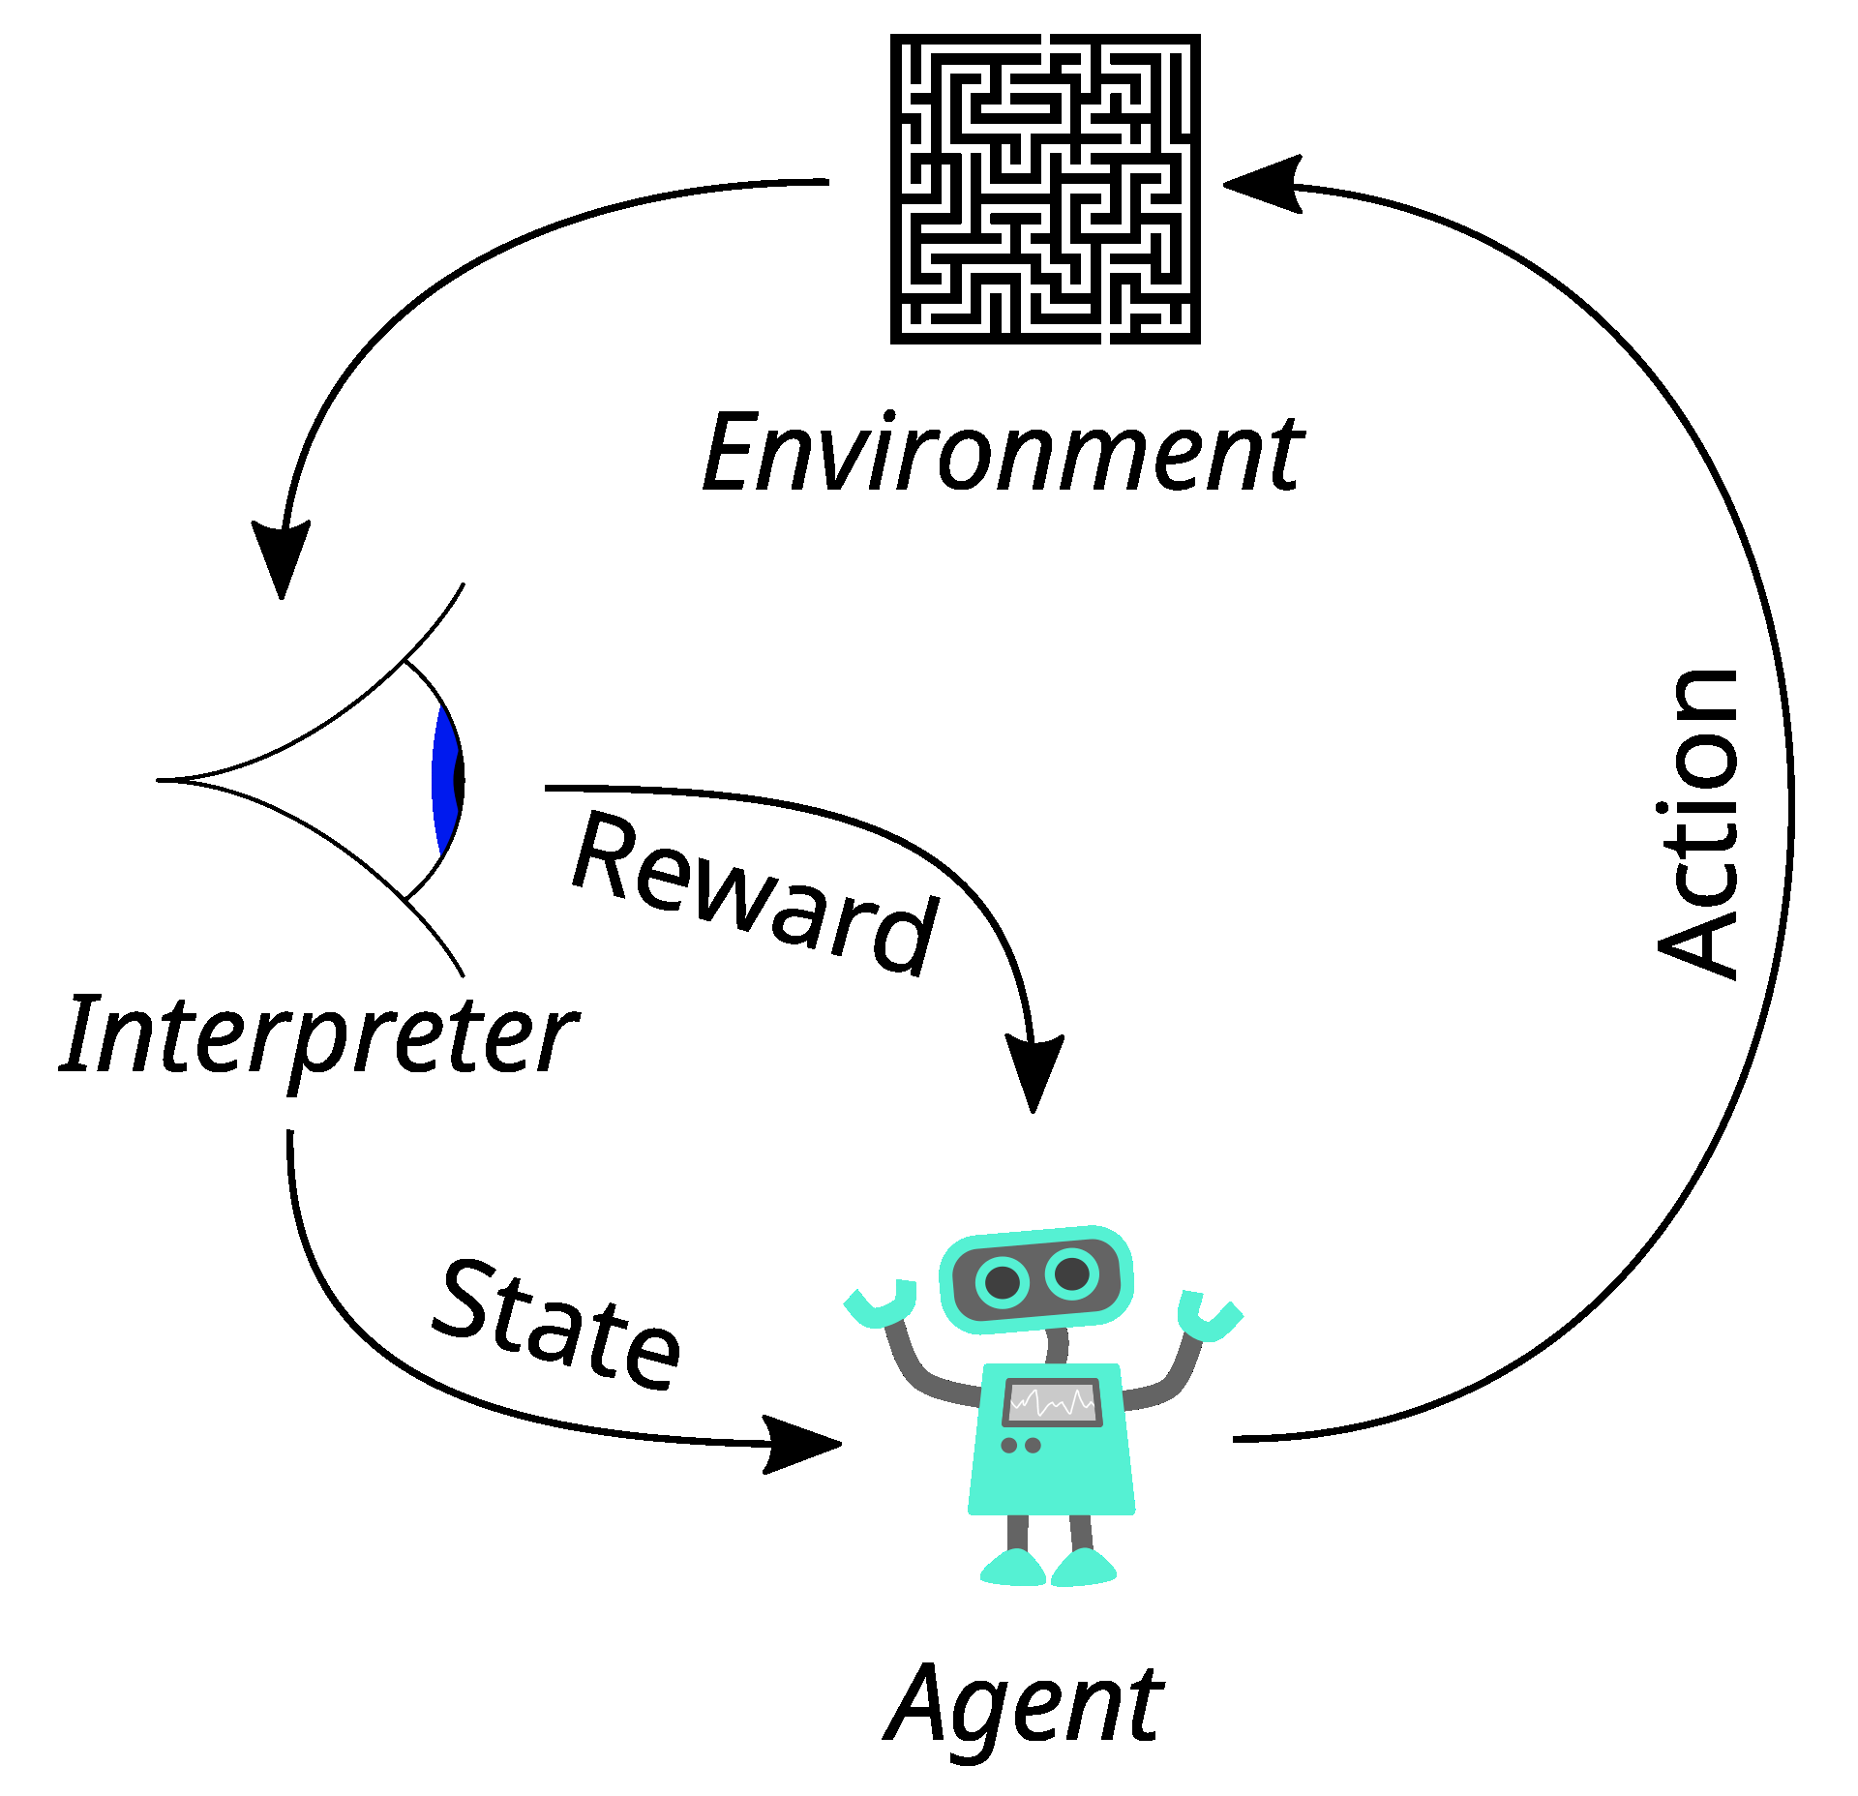
Background and Significance
C. Technologies May Involved in Object Tracking
Reinforcement Learning：

Slide 11
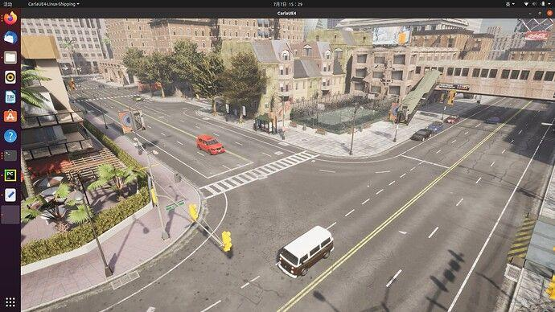
Background and Significance
D. The Carla Simulator

Slide 12
Outlines
1. Background and Significance
2. Analysis of Current Research Status
3. Completed Work
4. Research Plan and Expected Results
5. Potential Challenges and Solutions
6. References

Slide 13
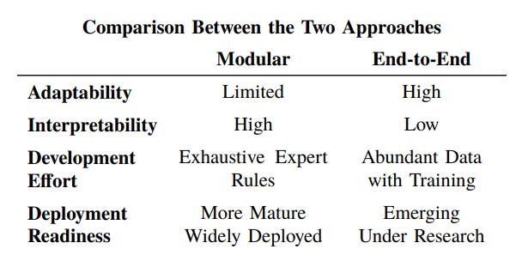
Analysis of Current Research Status
A. The Two Approaches
The Modular Approach vs. The End-to-End Approach:

Slide 14
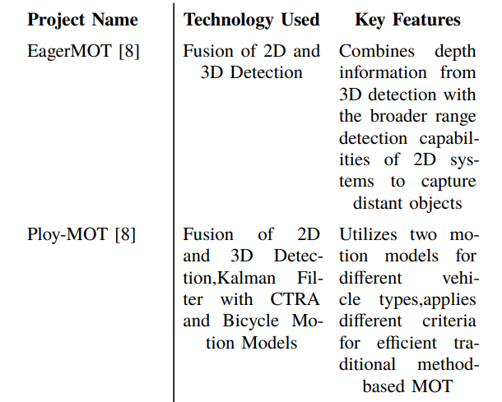
Analysis of Current Research Status
B. Analysis of Existing Literatures(By Comparison)
Traditional Models:

Slide 15
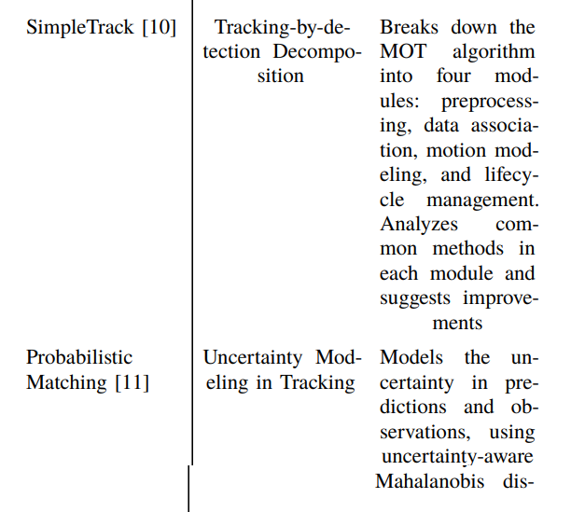
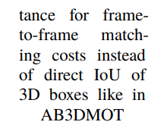
Analysis of Current Research Status
B. Analysis of Existing Literatures(By Comparison)
Traditional Models:

Slide 16
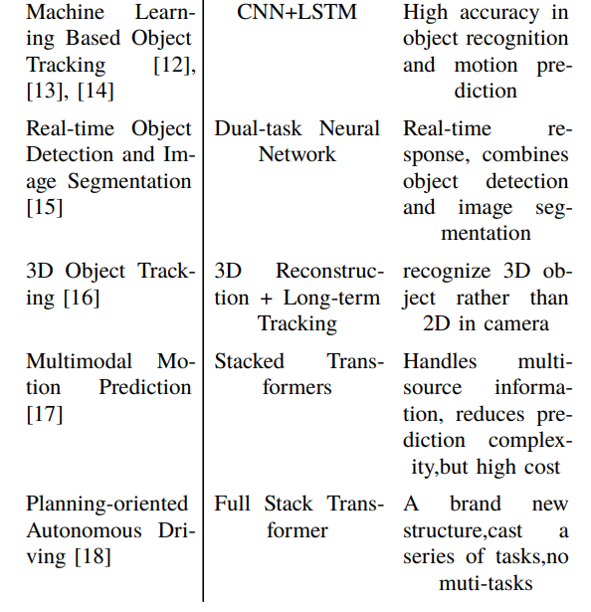
Analysis of Current Research Status
B. Analysis of Existing Literatures(By Comparison)
Machine Learning Models:

Slide 17
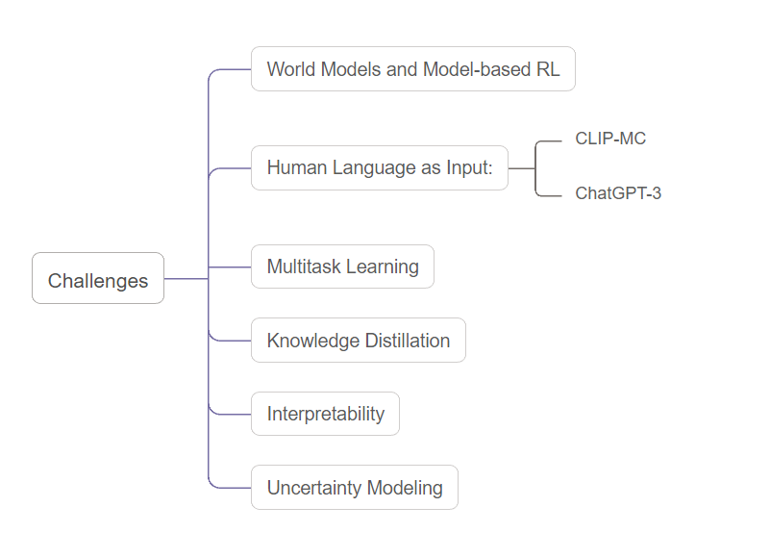
Analysis of Current Research Status
Challenges in Autonomous Driving: A Comprehensive Overview

Slide 18
Outlines
1. Background and Significance
2. Analysis of Current Research Status
3. Completed Work
4. Research Plan and Expected Results
5. Potential Challenges and Solutions
6. References

Slide 19
Completed Work
Environment Setup and Control
Data Collection System
Data Collection System
Preliminary Analysis

Slide 20
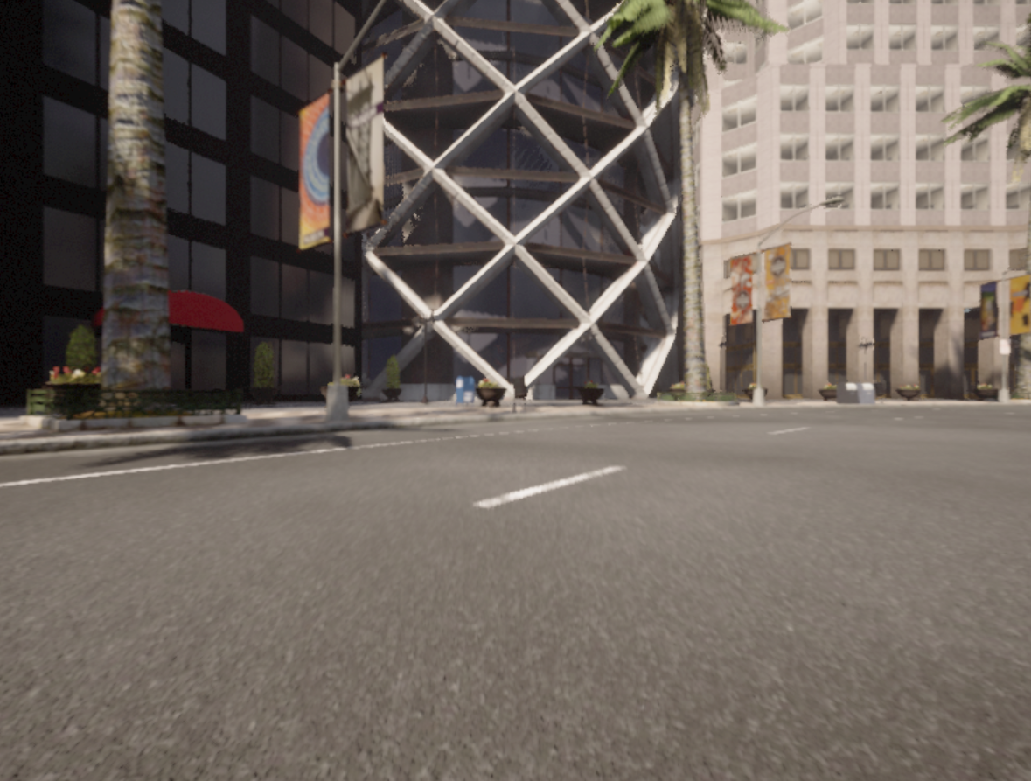
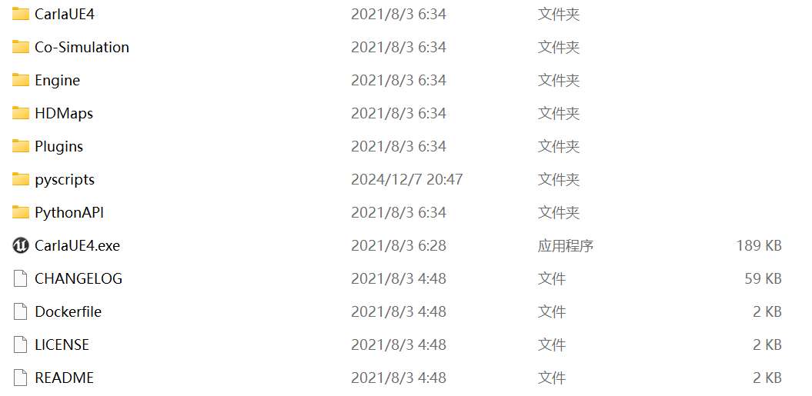
Environment Setup and Control

Slide 21
Outlines
1. Background and Significance
2. Analysis of Current Research Status
3. Completed Work
4. Research Plan and Expected Results
5. Potential Challenges and Solutions
6. References

Slide 22
Research Plan and Expected Results
Target Vehicle Detection System
Trajectory Recording System
Path Generation
Preliminary Analysis
Reinforcement Learning Control System
Integration and Testing
Timeline
Expected Results

Slide 23
Target Vehicle Detection System
a sophisticated camera-based vehicle detection algorithm
a robust identification mechanism.
comprehensive testing and optimization of detection accuracy
establishment of a precise coordinate extraction system.

Slide 24
Trajectory Recording System
an efficient data structure
advanced filtering methods for noise reduction
an optimized waypoint storage and retrieval system

Slide 25
Outlines
1. Background and Significance
2. Analysis of Current Research Status
3. Completed Work
4. Research Plan and Expected Results
5. Potential Challenges and Solutions
6. References

Slide 26
Timeline
Week 1-2: Target vehicle detection system development
Week 2-3: Trajectory recording system implementation
Week 3-4: Path generation system development
Week 4-5: RL control system implementation and training
Week 6: Integration, testing, and optimization

Slide 27
Potential Challenges and Solutions
Detection System
Trajectory Data Management
Path Generation
Reinforcement Learning Implementation
System Integration

Slide 28
Outlines
1. Background and Significance
2. Analysis of Current Research Status
3. Completed Work
4. Research Plan and Expected Results
5. Potential Challenges and Solutions
6. References

Slide 29
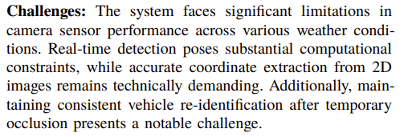
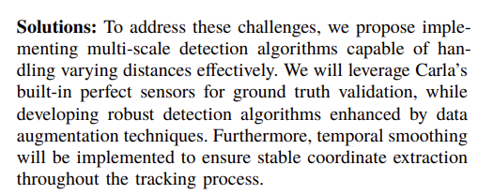
Detection System

Slide 30
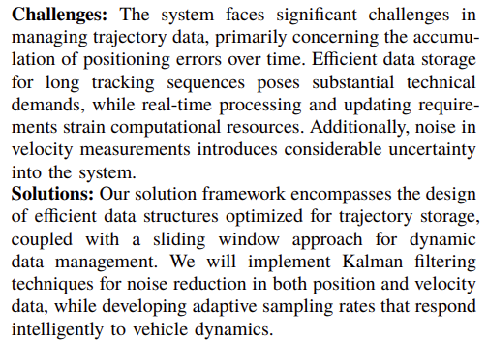
Trajectory Data Management

Slide 31
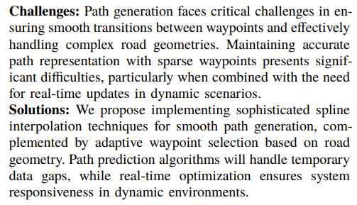
Path Generation
Detection System
Trajectory Data Management
Path Generation
Reinforcement Learning Implementation
System Integration

Slide 32
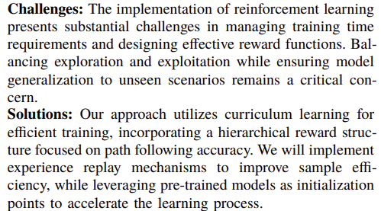
Reinforcement Learning Implementation

Slide 33
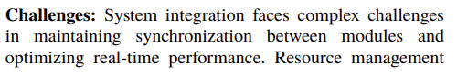
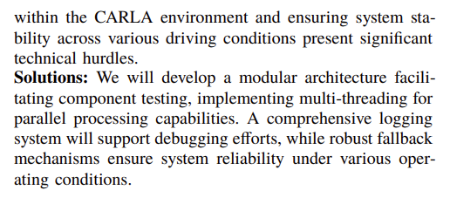
System Integration

Slide 34
Outlines
1. Background and Significance
2. Analysis of Current Research Status
3. Completed Work
4. Research Plan and Expected Results
5. Potential Challenges and Solutions
6. References

Slide 35
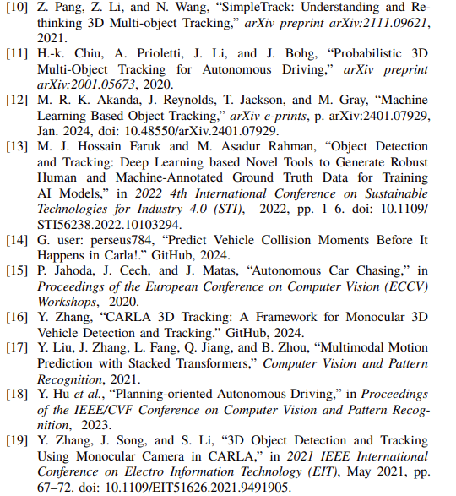
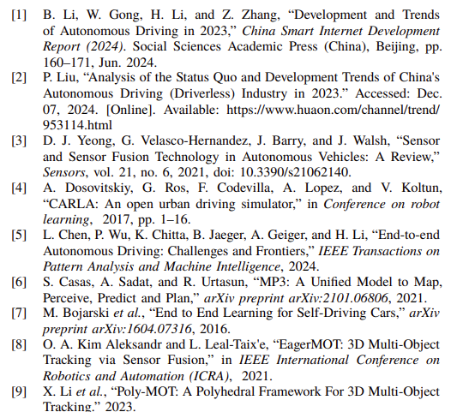
References

